Slide 1
Develop at Ubisoft
Angela Gervino

Slide 2
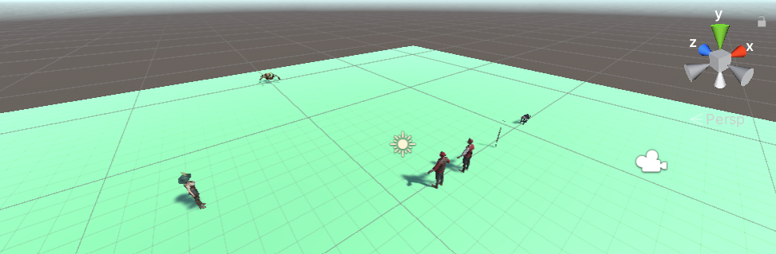
Before DAU
Notes:
Before starting this program, I had very little experience with making games but I had the goal of eventually creating a pirate-themed RPG.
To start working towards that goal I had followed some tutorials to develop some VERY simple games with Unity to gain some experience, and then I moved on to starting my own game. And this picture here shows the state of the game before starting this program. It just had some enemies that chased you around the platform but didn’t do anything when they caught up to you.
SO, my hope for this program was to take this progress and turn it into a complete game.

Slide 3
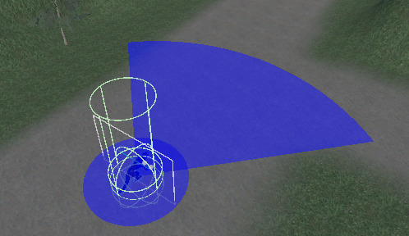
Program Goals
Make a complete game to gain exposure to many new aspects of game development
Explore the mathematics behind various game mechanics
Notes:
Since I had very little experience developing games, my main goal was to make a completed game so I could gain exposure to as many new things as possible such as combat systems and terrain building. And also from going through the process of building a game from start to end I could learn in what order I should work on different things when developing my own games.
I recalled from the few tutorials I had been through that camera movement seemed to be somewhat complicated, and I was interested to learn how it works mathematically. So one of the other goals I set for this program was to explore the mathematics behind some different game mechanics like camera movement and enemy detection ranges, and create some documents explaining in detail how or why these things work and include those with my final submission.

Slide 4
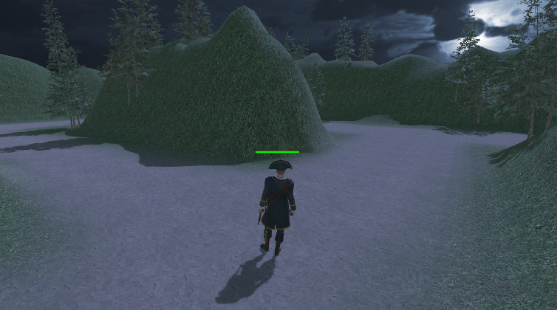
Island Escape
Setting: Play as a pirate who has just found buried treasure on an island
Goal: Find the way back to your pirate ship to escape with the treasure
Notes:
So, the game I’ve created is an escape game. You play as a pirate and when the game starts you’ve just found the buried treasure on an island. Your goal is to escape from the island with the treasure by making your way back to your pirate ship.
The island is basically a giant maze that you need to navigate without a map and your pirate ship is located at the end. But, as you make your way through the maze there will be evil monkeys that will chase you and you’ll have to fight them off.

Slide 5
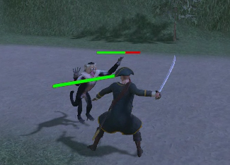
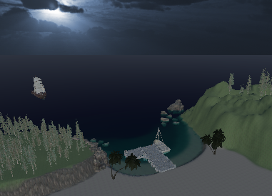
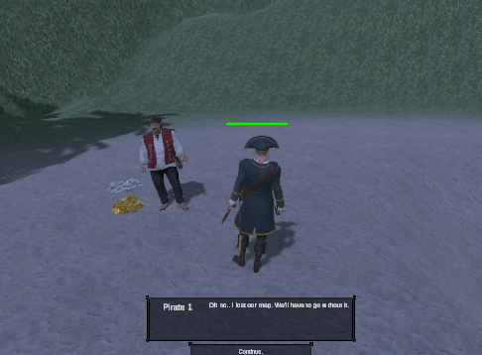
Progress
Combat System
Player Respawn
Input Blocking During Animations
Attack Cooldown
Environment
Terrain Building
Texture Painting
Crest Ocean System
Trees & Decorations
Dialogue
Dialogue Editor Tool
Input Blocking During Active Dialogue
Notes:
A lot of the time spent on this project was on the combat system. Currently the game includes the player and the one type of monkey enemy and each have only one type of attack. The monkeys do not respawn once they’ve been killed but player does respawn at the start of the maze with full health. I’ve also implemented input blocking while the player is dealing or taking damage so you can’t move mid-animation and also a cooldown time between the monkey’s attacks so that the player can’t get stuck endlessly taking damage.
I then moved on to working on the terrain. I learned how to build up the terrain and paint on textures and trees. I also wanted to add water around the island and I did that using the Crest Ocean System.
The last thing I worked on was the dialogue which I did using the Dialogue Editor tool. I have 2 NPC’s, one at the start of the maze explaining the goal of the game, and one at the end of the maze to congratulate you on escaping and off end the game. I also added input blocking so you can’t move or attack while the dialogue is active.

Slide 6
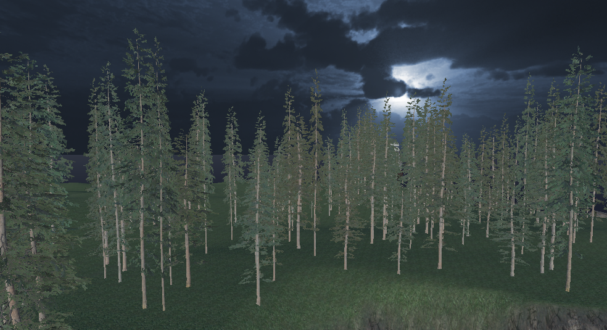
Obstacles
Obstacle: Lag
Solution: LOD Groups
Notes:
The biggest challenge I faced while working on this game was the lag that was caused by all the trees I had added to the terrain. While trying to fix the issue I learned about a few different ways to try and handle the lag, like enabling GPU instancing for the trees, disabling shadows, and using LOD Groups.
In the end, to fix the issue I used new tree assets that already had LOD Groups configured. For trees the player can actually get close to, I used these new trees as-is. And for trees that are far away or not accessible to the player I modified the LOD settings so that the trees always use the billboard LOD.

Slide 7
Thank You
Questions?
Notes:
Thank you for listening.

